Slide 1
Basic Android
Android Overview

Slide 2
Agenda
1.
Introduction to Android Architecture
2.
Introduction to Android automotive
3.
Prepare environment
4.
Create and Run an Android app
5.
USB Debugging

Slide 3
Introduction to Android Architecture

Slide 4
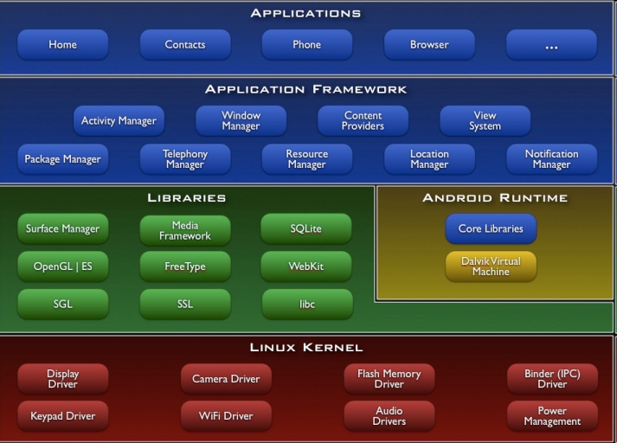
Architecture Android

Slide 5

Android S/W Stack - Application
Android provides a set of core applications:
Email Client
SMS Program
Calendar
Maps
Browser
Contacts
Etc
All applications are written using the Java language.

Slide 6
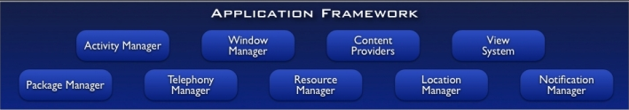
Android S/W Stack – App Framework
Enabling and simplifying the reuse of components
Developers have full access to the same framework APIs used by the core applications.
Users are allowed to replace components.

Slide 7
Android S/W Stack – App Framework(Cont)
Feature | Role
View System | Used to build an application, including lists, grids, text boxes, buttons, and embedded web browser
Content Provider | Enabling applications to access data from other applications or to share their own data
Resource Manager | Providing access to non-code resources (localized strings, graphics, and layout files)
Notification Manager | Enabling all applications to display customer alerts in the status bar
Activity Manager | Managing the lifecycle of applications and providing a common navigation backstack

Slide 8
Android S/W Stack – App Framework
Enabling and simplifying the reuse of components
Developers have full access to the same framework APIs used by the core applications.
Users are allowed to replace components.

Slide 9
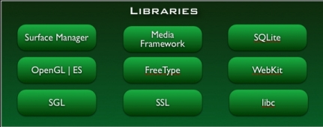
Android S/W Stack – Libraries
Including a set of C/C++ libraries used by components of the Android system
Exposed to developers through the Android application framework

Slide 10
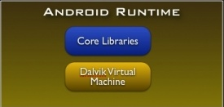
Android S/W Stack – Runtime
Core Libraries
Providing most of the functionality available in the core libraries of the Java language
APIs
Data Structures
Utilities
File Access
Network Access
Graphics
Etc

Slide 11
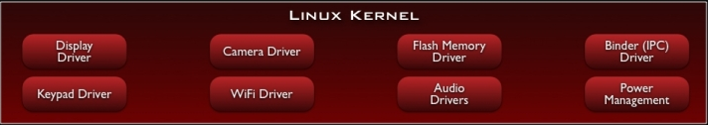
Android S/W Stack – Linux Kernel
Relying on Linux Kernel 2.6 for core system services
Memory and Process Management
Network Stack
Driver Model
Security
Providing an abstraction layer between the H/W and the rest of the S/W stack

Slide 12
Introduction to Android automotive

Slide 13
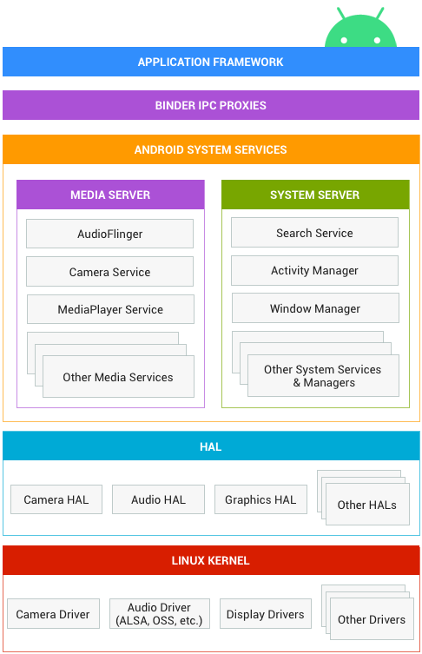
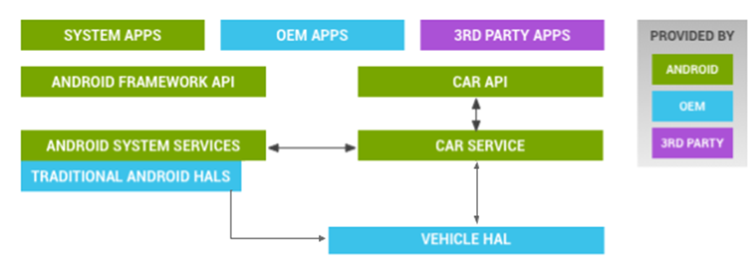
Introduction to Android automotive
Android System architecture
Android Automotive architecture
Applications
Framework
LINUX KERNEL
Android Core
Android Car
HAL
Android Automotive is Android
Same codebase, same repository
Leverages the existing resources
Android Automotive extends Android
Adding support for automotive
Android Automotive offers:
Openness
Customization
Scale
BSP

Slide 14
Prepare environment

Slide 15

Tools
Phone
Android Studio (Download Android Studio & App Tools - Android Developers)

Slide 16

Android SDK
Once installed open the SDK Manager
Install the desired packages
Create an Android Virtual Device (AVD)

Slide 17
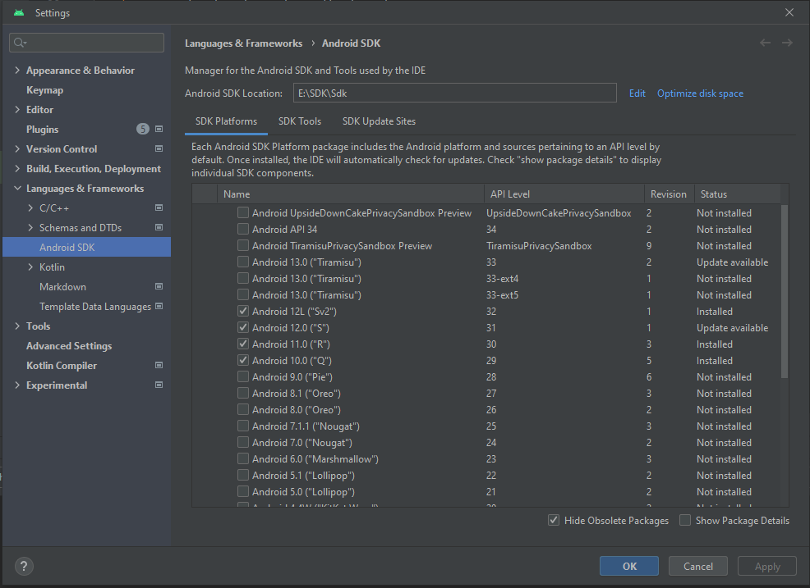
SDK Manager

Slide 18
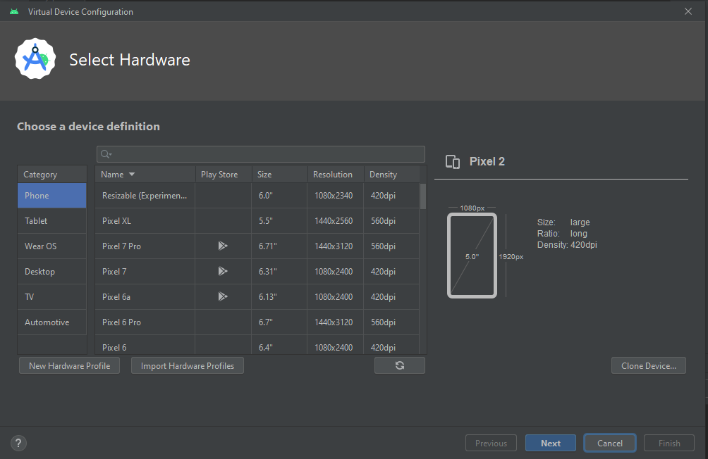
AVD

Slide 19
Create and Run an Android app

Slide 20
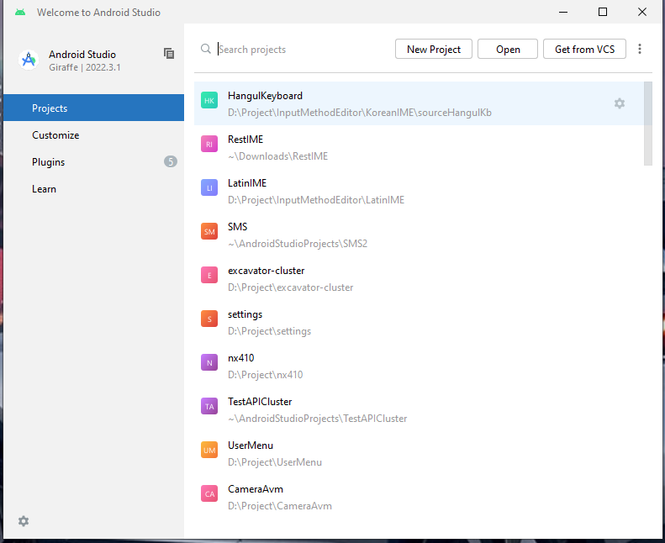
Creating a Project
Run Android Studio> Click to ‘New Project’

Slide 21
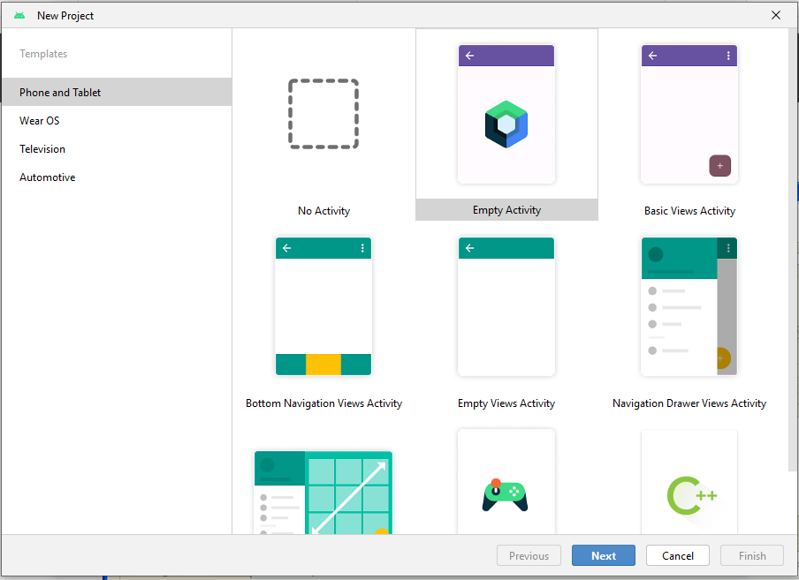
Creating a Project (Cont)
Select ‘Phone and Tablet’
select any template
2
1

Slide 22
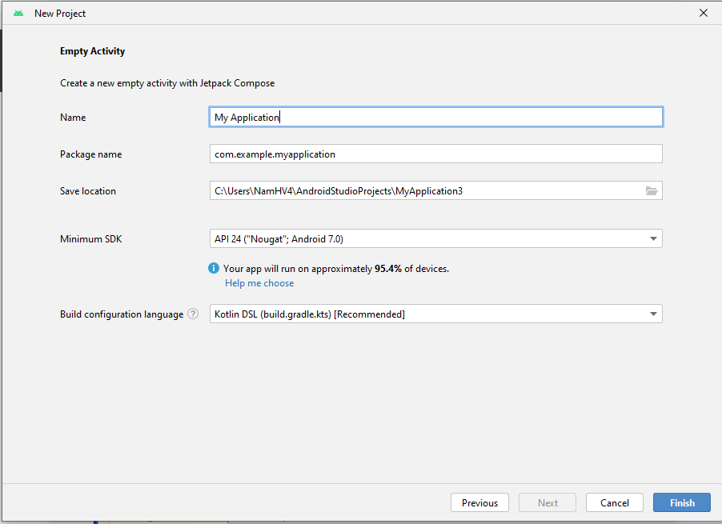
Creating a Project (Cont)
Fill up:
Name: Name of application
Package name: format com.xxx.xxx
Save location
Minimum SDK
Build config.

Slide 23
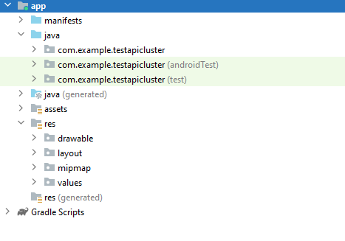
Project Components
App
Mainifests
Java
Java (generated)
Assets
res
Drawable
Layout
Mipmap
values
Gradle: Config build, add library

Slide 24
Manifest File
Contains characteristics about your application
When have more than one Activity in app, NEED to specify it in manifest file
Go to graphical view of the manifest file
Add an Activity in the bottom right
Browse for the name of the activity
Need to specify Services and other components too
Also important to define permissions and external libraries, like Google Maps API

Slide 25
R Class
Auto-generated: you shouldn’t edit it
Contains IDs of the project resources
Enforces good software engineering
Use findViewById and Resources object to get access to the resources
Ex. Button b = (Button)findViewById(R.id.button1)
Ex. getResources().getString(R.string.hello));

Slide 26
USB Debugging

Slide 27
USB Debugging
Should be enabled on phone to use developer features
In the main apps screen select Settings -> Applications -> Development -> USB debugging (it needs to be checked

Slide 28
Android Debug Bridge
Used for a wide variety of developer tasks
Read from the log file
Show what android devices are available
Install android applications (.apk files)
In the ‘platform-tools’ directory of the main android sdk directory
Recommend putting this directory and the ‘tools’ directory on the system path
adb.exe

Slide 29
Debugging
Instead of using traditional System.out.println, use the Log class
Imported with android.util.Log
Multiple types of output (debug, warning, error, …)
Log.d(<tag>,<string>)
Can be read using logcat.
Print out the whole log, which auto-updates
adb logcat
Erase log
adb logcat –c
Filter output via tags
adb logcat <tag>:<msg type> *:S
can have multiple <tag>:<msg type> filters
<msg type> corresponds to debug, warning, error, etc.
If use Log.d(), then <msg type> = D
Reference
http://developer.android.com/guide/developing/debugging/debugging-log.html

Slide 30
References
This lesson is a brief overview of some major concepts
Developer’s Guide
http://developer.android.com/guide/index.html
API Reference
http://developer.android.com/reference/packages.html

Slide 31
THANK YOU!

